Slide 1
GRAPH CONVOLUTIONAL NETWORKS (GCN)
Matplotlib
Data Visualization with Python
A practical introduction to Pyplot, chart types, the Object-Oriented API, and Saving Plots.
Name: Hafiz Waseem Ahmed
Roll Number: 13
01

Slide 2
01 · INTRODUCTION
What Is Matplotlib, and Why Does It Matter?
Matplotlib is Python's foundational data visualization library — it turns numbers into charts: lines, bars, scatter plots, histograms, and more.
Why visualize at all? Raw numbers are hard to reason about; a well-made chart reveals patterns, trends, and outliers in seconds.
In Data Science, AI, and ML, Matplotlib shows up constantly — exploring a dataset, checking a model's training progress, comparing results, and building figures for reports and papers.
It's also the foundation other libraries (like Seaborn) are built on top of — learning it well pays off across the whole ecosystem.
Matplotlib: Data Visualization with Python · GCN Course
02

Slide 3
01 · INTRODUCTION
The Basic Visualization Workflow
→
→
→
1
2
3
4
Data
Plot
Customize
Show / Save
Lists, arrays, or DataFrame columns for X and Y.
plt.plot() / bar() / scatter() / ... draws the chart.
Titles, labels, legend, grid, color, style.
plt.show() to view, plt.savefig() to export.
Matplotlib: Data Visualization with Python · GCN Course
03

Slide 4
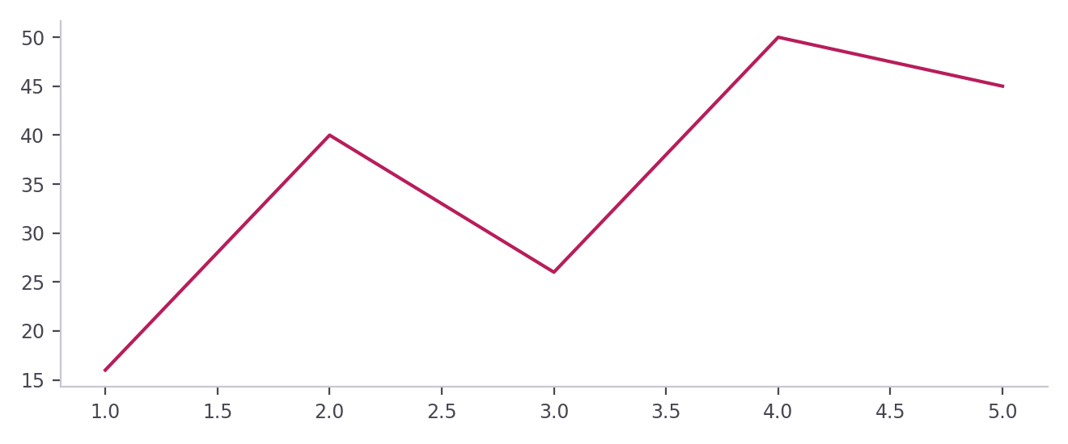
01 · INTRODUCTION
Importing Pyplot & Your First Plot
import matplotlib.pyplot as plt
x = [1, 2, 3, 4, 5]
y = [16, 40, 26, 50, 45]
plt.plot(x, y)
plt.show()
Parameter | Meaning
import matplotlib.pyplot as plt | Loads Pyplot under the short name plt
x | Values plotted on the X-axis
y | Values plotted on the Y-axis
plt.plot(x, y) | Draws a line through the (x, y) points
plt.show() | Displays the figure
Matplotlib: Data Visualization with Python · GCN Course
04

Slide 5
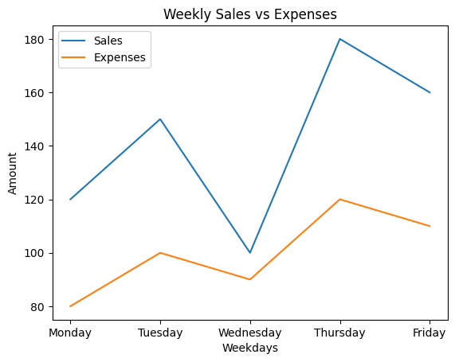
01 · INTRODUCTION
Weekly Sales vs Expenses
days = ["Monday", "Tuesday", "Wednesday", "Thursday", "Friday"]
sales = [120, 150, 100, 180, 160]
expenses = [80, 100, 90, 120, 110]
plt.plot(days, sales, label="Sales")
plt.plot(days, expenses, label="Expenses")
plt.title("Weekly Sales vs Expenses")
plt.xlabel("Weekdays")
plt.ylabel("Amount")
plt.legend()
plt.show()
Parameter | Meaning
days | Category names on the X-axis
sales, expenses | Y-values of the two lines
label="Sales" | Name of the line in the legend
plt.title("...") | Heading of the chart
plt.xlabel("...") | Text describing the X-axis
plt.ylabel("...") | Text describing the Y-axis
plt.legend() | Shows the legend built from the labels
plt.show() | Displays the figure
Matplotlib: Data Visualization with Python · GCN Course
05

Slide 6
02 · FOUNDATIONS
Essential Terminology
The shared vocabulary we'll use for the rest of this talk.
06

Slide 7
02 · TERMINOLOGY
Describing & Labeling a Plot
1
Plot
2
Marker
3
Line Style
4
Color
A visual representation of data: a line, bar, scatter, etc.
The symbol at each data point: circle, triangle, x.
How a line looks: solid, dashed, dotted.
The visual color of a line, bar, or marker.
5
Label
6
Title
7
Legend
8
Grid
Text describing a data series, axis, or point.
The heading text that names the chart.
A key mapping colors/markers to what they represent.
Light background lines that help read values.
Matplotlib: Data Visualization with Python · GCN Course
07

Slide 8
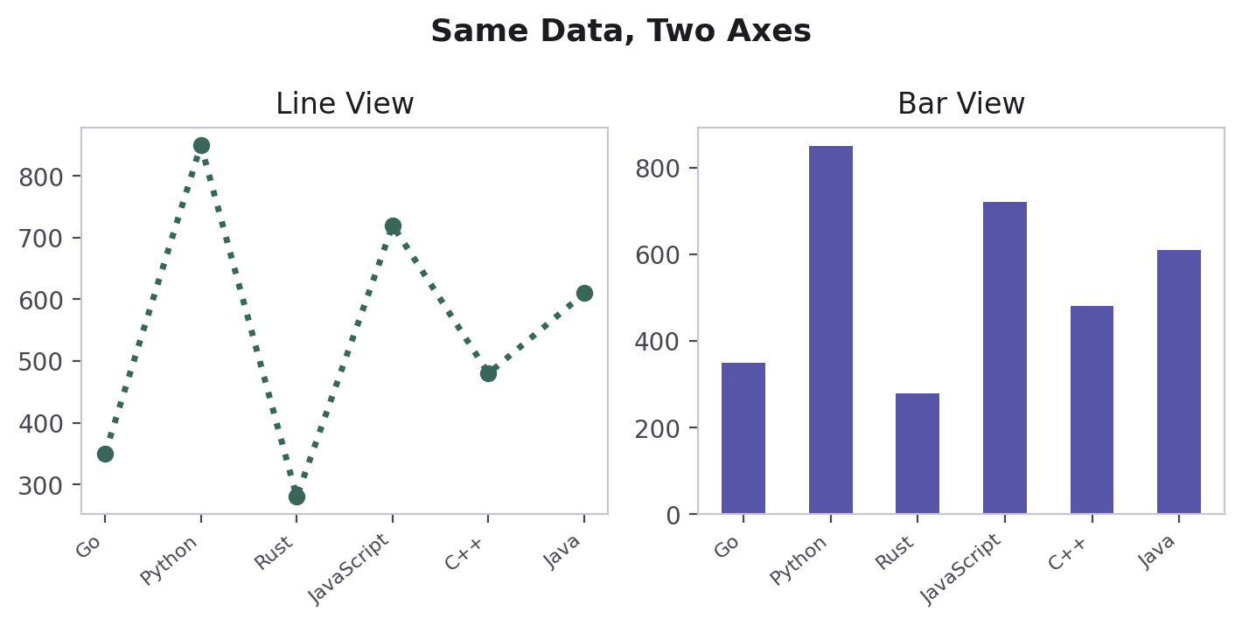
02 · TERMINOLOGY
Figure vs. Axes — Visualized
Figure
A Figure is the whole canvas — the entire window or saved image file.
An Axes is one plot area living inside that Figure — it holds the X-axis, Y-axis, title, legend, and data.
One Figure can contain many Axes — that's exactly what Subplots are (coming up shortly).
Every plt.plot(), plt.title(), etc. call quietly targets "the current Axes" of "the current Figure."
Axes
Y-axis
X-axis
Matplotlib: Data Visualization with Python · GCN Course
08

Slide 9
03 · PYPLOT
Pyplot — The Core of Matplotlib
Line, bar, pie, histogram, and scatter plots — each with its syntax, parameters, and a code example.
09

Slide 10
03 · PYPLOT
Line Plot — plt.plot() Syntax
Parameter | Meaning
x | Data for the X-axis
y | Data for the Y-axis
color | Color of the line
linestyle | Line style: ":", "--" or "-."
linewidth | Thickness of the line
marker | Symbol at each point: "o", "x", "^"
label | Name used in the legend
plt.plot(
x,
y,
color="color_name",
linestyle="line_style",
linewidth=value,
marker="marker_style",
label="label_name"
)
Matplotlib: Data Visualization with Python · GCN Course
10

Slide 11
03 · PYPLOT
Grid Options — plt.grid()
Call | Meaning
plt.grid() | Turns the grid on
plt.grid(True) | Explicitly turns the grid on
plt.grid(False) | Turns the grid off
plt.grid(axis="y") | Horizontal grid lines only
plt.grid(axis="x") | Vertical grid lines only
plt.grid(axis="both") | Both horizontal and vertical grid lines
plt.grid(linestyle=":") | Changes the grid line style
plt.grid(linewidth=0.5) | Changes the grid line width
plt.grid(alpha=0.5) | Changes the grid transparency (0 to 1)
plt.grid(axis="both", linestyle=":", linewidth=4, alpha=0.7) | Combines several properties in one call
Matplotlib: Data Visualization with Python · GCN Course
11

Slide 12
03 · PYPLOT
Bar Chart — plt.bar() Syntax
Parameter | Meaning
x | Category names / positions
Height / value | Values represented by the bars
color | Bar color
width | Width of each bar
label | Name used in the legend
plt.bar(
x, # Category Name
height, # Bar Height / Value
color="Color Name",
width=value,
label="Label Name"
)
Matplotlib: Data Visualization with Python · GCN Course
12

Slide 13
03 · PYPLOT
Pie Chart — plt.pie() Syntax
Parameter | Meaning
values | Numbers represented by each slice
labels | Names of the slices
colors | Colors of the slices
autopct | Shows the percentage on each slice
plt.pie(
values,
labels=labels_list,
colors=color_list,
autopct="%1.1f%%"
)
Matplotlib: Data Visualization with Python · GCN Course
13

Slide 14
03 · PYPLOT
Histogram — plt.hist() Syntax
Parameter | Meaning
data | Numbers distributed into bins
bins | Number of intervals / groups
color | Color of the bars
edgecolor | Color of each bar's border
plt.hist(
data,
bins=number_of_bins,
color="color_name",
edgecolor="black"
)
Matplotlib: Data Visualization with Python · GCN Course
14

Slide 15
03 · PYPLOT
Scatter Plot — plt.scatter() Syntax
Parameter | Meaning
x | Data for the X-axis
y | Data for the Y-axis
color | Color of the points
marker | Shape / style of the points
label | Name used in the legend
plt.scatter(
x,
y,
color="color_name",
marker="style",
label="label name"
)
Matplotlib: Data Visualization with Python · GCN Course
15

Slide 16
05 · SUBPLOTS & OO API
Subplots & the Object-Oriented API
Combining multiple charts in one Figure, and the more explicit way of writing Matplotlib code used throughout real projects.
16

Slide 17
05 · SUBPLOTS
Subplots — plt.subplot() Syntax
Parameter | Meaning
nrows | Number of rows in the grid
ncolumns | Number of columns in the grid
index | Panel number — 1-based, not 0-based
plt.subplot(
nrows,
ncolumns,
index # Here indexing is not 0-based. It is 1-based
)
Matplotlib: Data Visualization with Python · GCN Course
17

Slide 18
05 · SUBPLOTS
Subplots — plt.subplots() Syntax
Parameter | Meaning
fig | The whole Figure (canvas)
ax | The Axes — one panel per grid cell
nrows | Number of rows in the grid
ncolumns | Number of columns in the grid
figsize | Optional (width, height) tuple of the Figure
fig, ax = plt.subplots(
nrows,
ncolumns,
figsize=(width,height) # Tuple: But this is optional
)
Matplotlib: Data Visualization with Python · GCN Course
18

Slide 19
05 · OBJECT-ORIENTED API
Two Ways to Write Matplotlib Code
PYPLOT
OBJECT-ORIENTED
plt.plot(x, y)
plt.title("Sales")
plt.xlabel("Month")
plt.legend()
fig, ax = plt.subplots()
ax.plot(x, y)
ax.set_title("Sales")
ax.set_xlabel("Month")
ax.legend()
Implicit: Matplotlib tracks "the current" figure and axes for you. Quick for a single chart.
Explicit: you name exactly which Axes you're drawing on. Scales cleanly to subplots and reusable functions.
Matplotlib: Data Visualization with Python · GCN Course
19

Slide 20
06 · SAVING PLOTS
Saving Plots — plt.savefig() Syntax
Parameter | Meaning
filename.file_extension | File name + format, e.g. .png
dpi | Resolution in dots per inch
bbox_inches | Area of the figure that is saved
savefig(
"filename.file_extension",
dpi=value,
bbox_inches="inches value"
)
Matplotlib: Data Visualization with Python · GCN Course
20

Slide 21
07 · USEFUL EXTRAS
A Few More Tools You'll Reach For
Parameter | Meaning
figsize=(w, h) | Sets the Figure's size, in inches
dpi= | Controls image resolution/sharpness
plt.savefig("file.png", dpi=300) | Exports the current figure to a file
plt.xlim() / plt.ylim() | Fixes the visible axis range
plt.xticks() / plt.yticks() | Sets custom tick positions and labels
plt.tight_layout() | Automatically fixes spacing so labels don't overlap
Matplotlib: Data Visualization with Python · GCN Course
21

Slide 22
Thank You
Questions?
Matplotlib: Data Visualization with Python · GCN
22

